Slide 1
Direct Percolation in Predator-Prey dynamics
Physics of Data – Physics of Complex Systems
Malagoli Pietro
October 27, 2025
Pietro Malagoli – Direct Percolation in Predator-Prey dynamics
1
Notes:
1

Slide 2
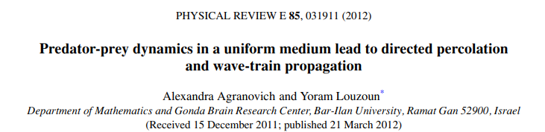
INTRODUCTION
For this project, I have reproduced the results from the paper by Agranovich and Louzoun “Predator-prey dynamics in a uniform medium lead to directed percolation and wave-train propagation” (Physical Review E 85, 031911; 2012).
Pietro Malagoli – Direct Percolation in Predator-Prey dynamics
2

Slide 3
ABSTRACT (1)
The paper studies an Immune System - Pathogen (ISP) problem, which is a birth-death process with two fixed points, starting from a small perturbation from the zero-pathogen absorbing state.
Primarly, this paper shows how, when taking into account the natural discretization of the ISP populations, complex behaviours emerge:
A DP regime, due to the balance of extinction and proliferation in different regions.
A wave trains regime leading to the mean-field stable positive fixed point.
Pietro Malagoli – Direct Percolation in Predator-Prey dynamics
3

Slide 4
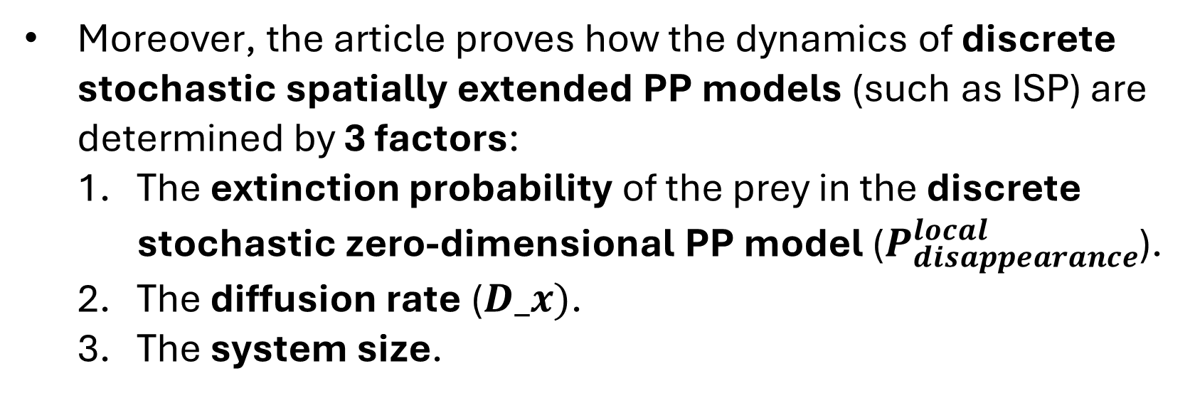
ABSTRACT (2)
Moreover, the article proves how the dynamics of discrete stochastic spatially extended PP models (such as ISP) are determined by 3 factors:
The extinction probability of the prey in the discrete stochastic zero-dimensional PP model ($P_{disappearance}^{local}$).
The diffusion rate ($D_x)$.
The system size.
Pietro Malagoli – Direct Percolation in Predator-Prey dynamics
4

Slide 5
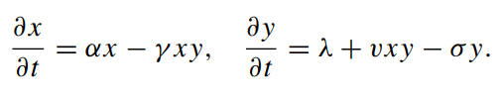
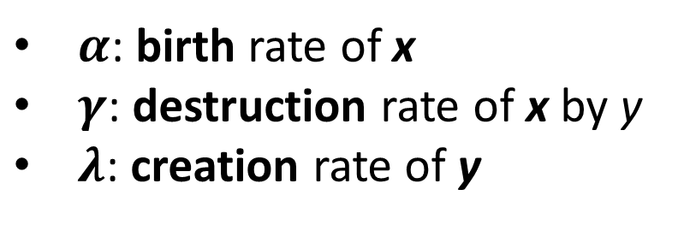
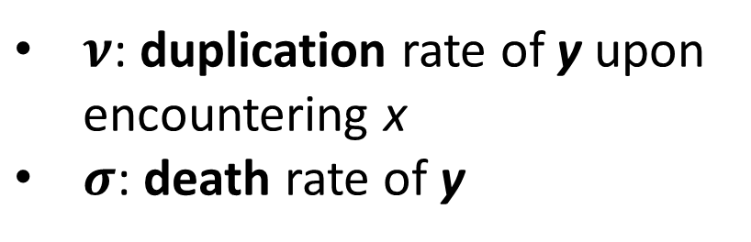
MEAN-FIELD
The ISP dynamics can be reduced to a PP system:
Where x is the pathogens’ and y the lymphocytes’ population and:
$α$: birth rate of x
$γ$: destruction rate of x by y
$λ$: creation rate of y
$ν$: duplication rate of y upon encountering x
$σ$: death rate of y
Pietro Malagoli – Direct Percolation in Predator-Prey dynamics
5

Slide 6
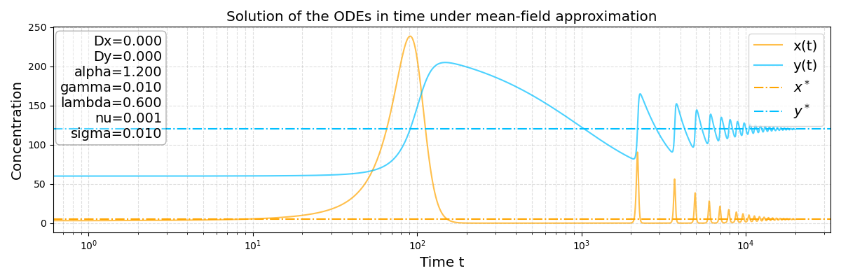
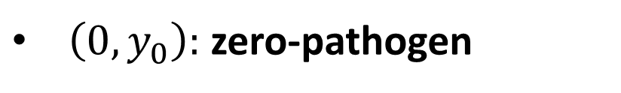
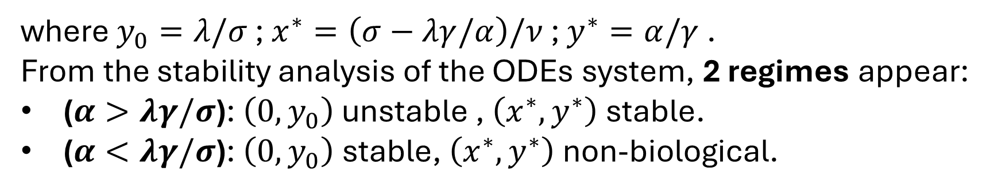
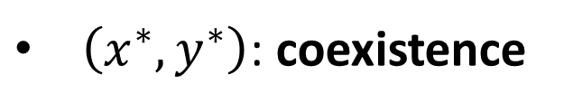
MEAN-FIELD: FIXED POINTS
The ODEs system presents 2 fixed points:
$\left(0,y_{0}\right):$ zero-pathogen
$\left(x^{∗},y^{∗}\right)$: coexistence
where $y_{0}=λ/σ$ ; $x^{∗}=\left(σ−λγ/α\right)/ν$ ; $y^{∗}=α/γ$ .
From the stability analysis of the ODEs system, 2 regimes appear:
($α>λγ/σ$): $\left(0,y_{0}\right)$unstable , $\left(x^{∗},y^{∗}\right)$stable.
($α<λγ/σ$): $\left(0,y_{0}\right)$ stable, $\left(x^{∗},y^{∗}\right)$ non-biological.
Pietro Malagoli – Direct Percolation in Predator-Prey dynamics
6

Slide 7
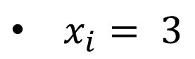
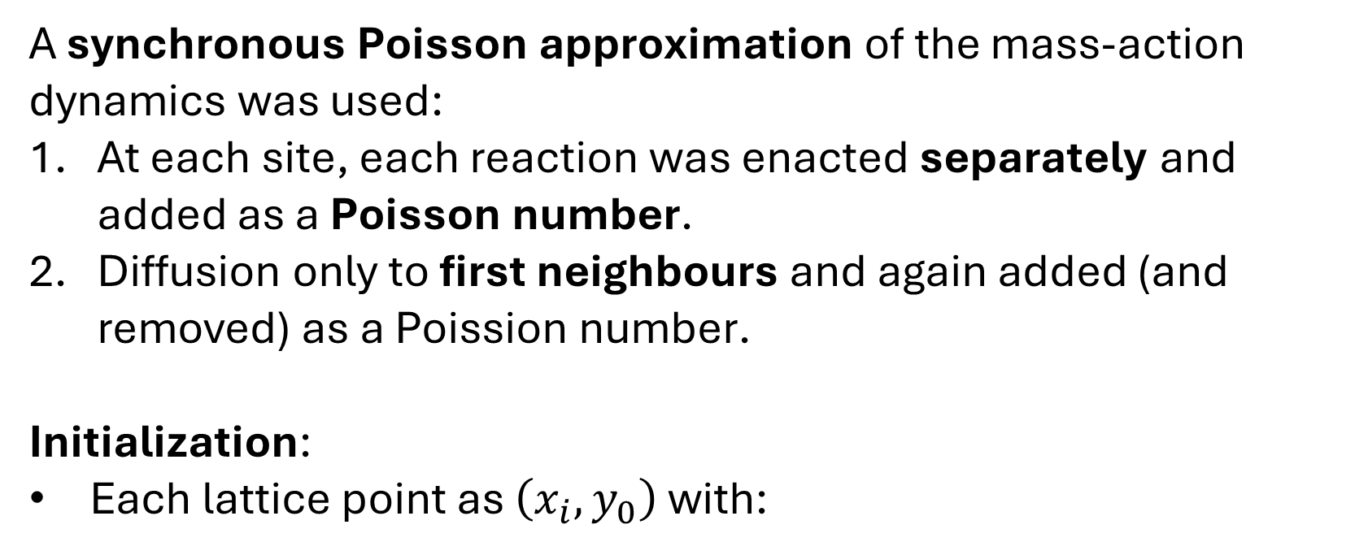
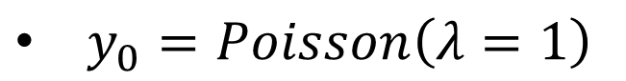
METHODS: ISP
A synchronous Poisson approximation of the mass-action dynamics was used:
At each site, each reaction was enacted separately and added as a Poisson number.
Diffusion only to first neighbours and again added (and removed) as a Poission number.
Initialization:
Each lattice point as $\left(x_{i},y_{0}\right)$ with:
$x_{i}= 3$
$y_{0}=Poisson\left(λ=1\right)$
Pietro Malagoli – Direct Percolation in Predator-Prey dynamics
7

Slide 8
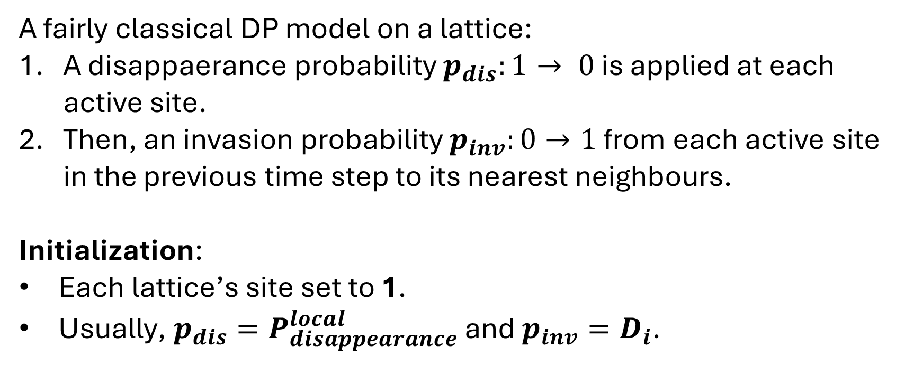
METHODS: DP
A fairly classical DP model on a lattice:
A disappaerance probability $p_{dis}:1→ 0$ is applied at each active site.
Then, an invasion probability $p_{inv}:0→1$ from each active site in the previous time step to its nearest neighbours.
Initialization:
Each lattice’s site set to 1.
Usually, $p_{dis}=P_{disappearance}^{local}$ and $p_{inv}=D_{i}$.
Pietro Malagoli – Direct Percolation in Predator-Prey dynamics
8

Slide 9
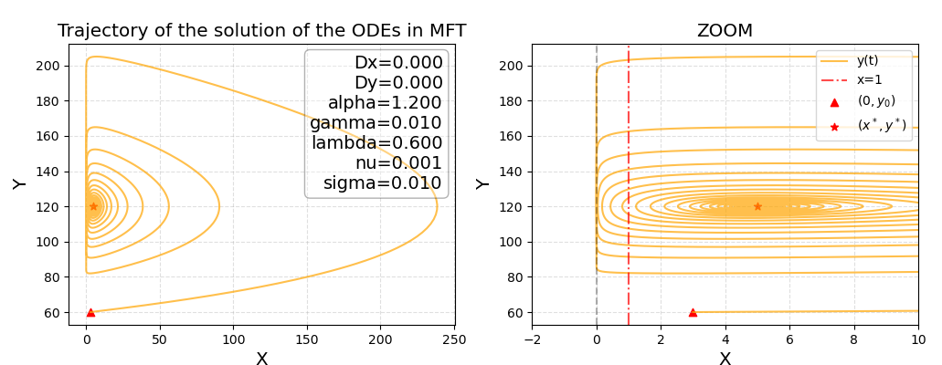
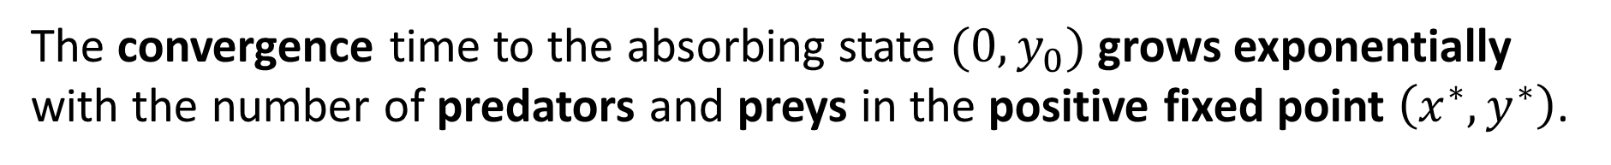
RESULTS: MFT
The MFT model is an extension of the Lotka-Volterra PP model, with a nonzero-predator basal concentration.
In the continuous approximation, the prey population can be lowered infinitely towards zero without extinction occurring.
The convergence time to the absorbing state $(0,y_{0})$grows exponentially with the number of predators and preys in the positive fixed point $\left(x^{∗},y^{∗}\right)$.
Pietro Malagoli – Direct Percolation in Predator-Prey dynamics
9

Slide 10
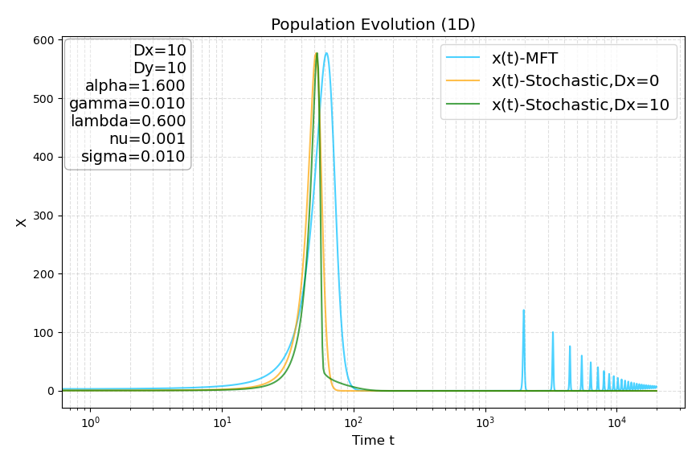
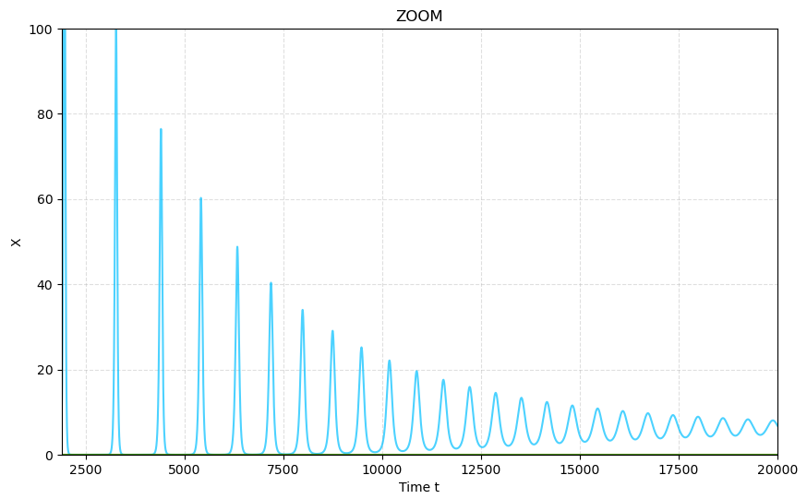
MFT vs ISP
For high value of disappearance probability, the ISP model (both with and without diffusion) undergoes extinction at the first pass near zero, in opposition to what the continuous MFT approximation predicts.
Pietro Malagoli – Direct Percolation in Predator-Prey dynamics
10

Slide 11
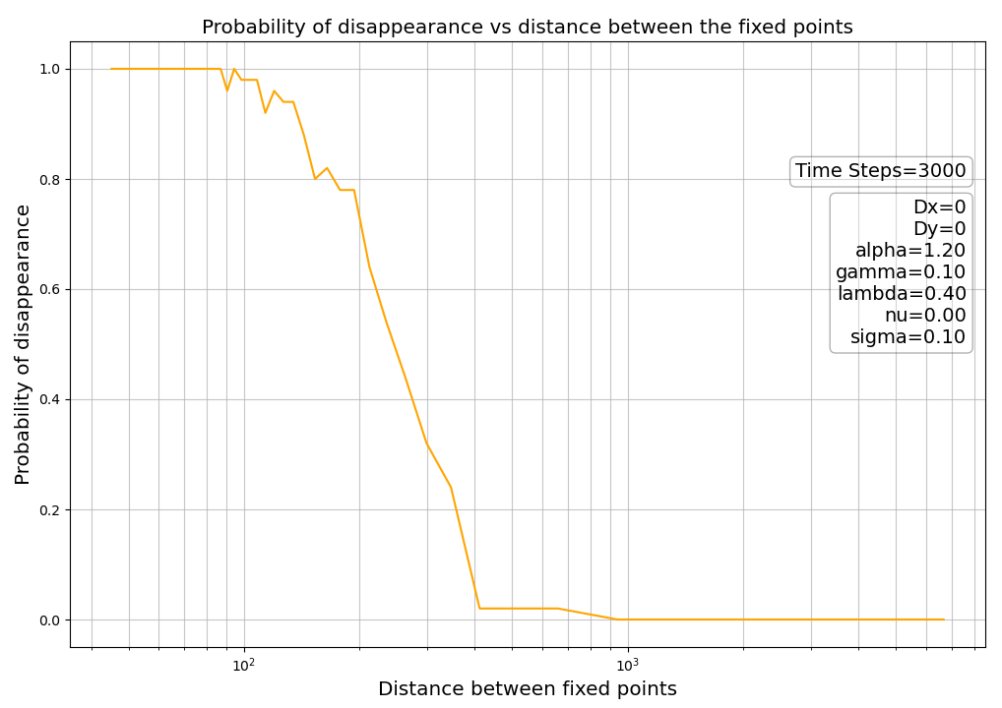

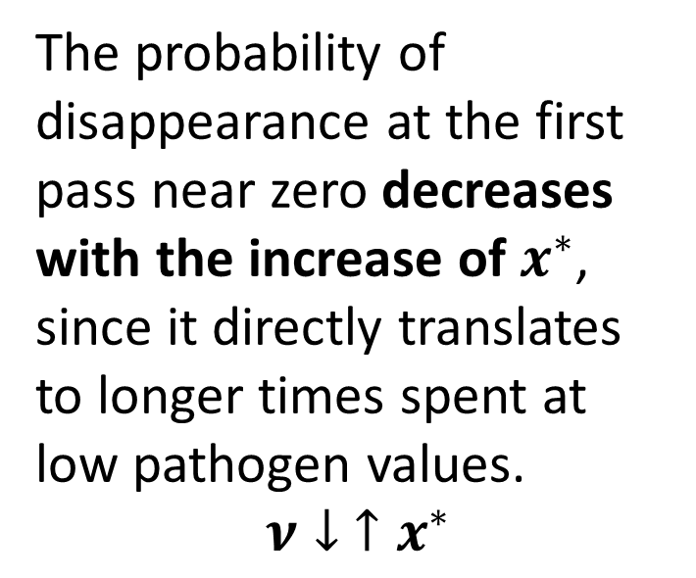
RESULTS: $P_{disappearance}^{local}$
The probability of extinction at the first pass near zero increases with the time spent at low pathogen values.
The probability of disappearance at the first pass near zero decreases with the increase of $x^{∗}$, since it directly translates to longer times spent at low pathogen values.
$$ν↓ ↑x^{∗}$$
Pietro Malagoli – Direct Percolation in Predator-Prey dynamics
11

Slide 12
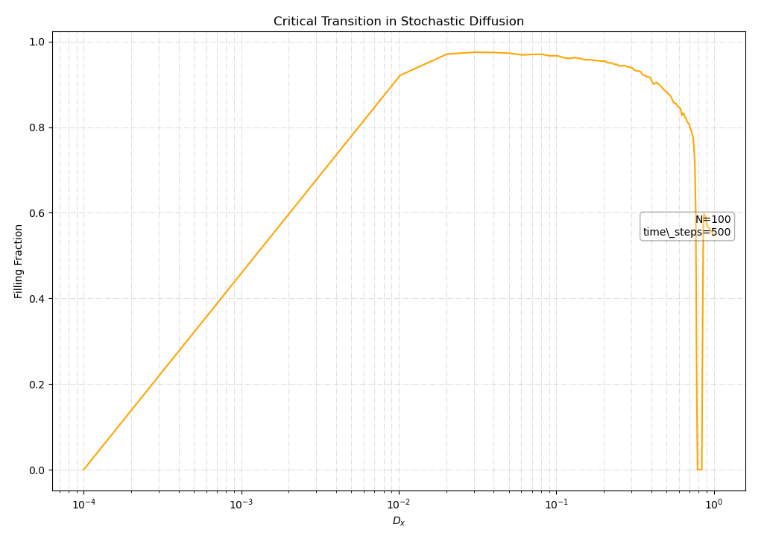

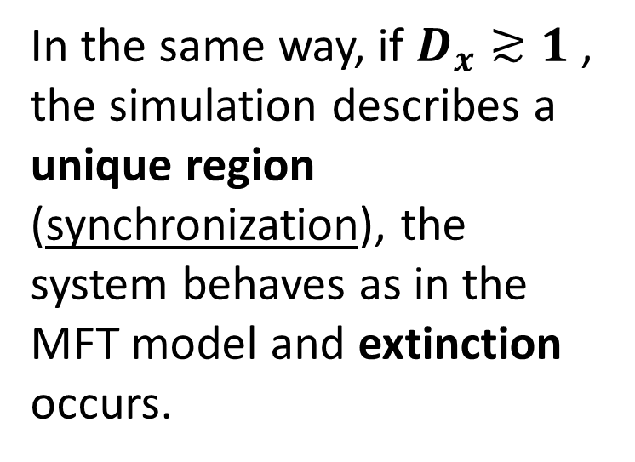
RESULTS: DIFFUSION
Without diffusion, the simulation is an ensemble of zero-dimensional systems and if $P_{disappearance}^{local}$ is high, extinction occurs.
In the same way, if $D_{x}≳1$ , the simulation describes a unique region (synchronization), the system behaves as in the MFT model and extinction occurs.
Pietro Malagoli – Direct Percolation in Predator-Prey dynamics
12

Slide 13
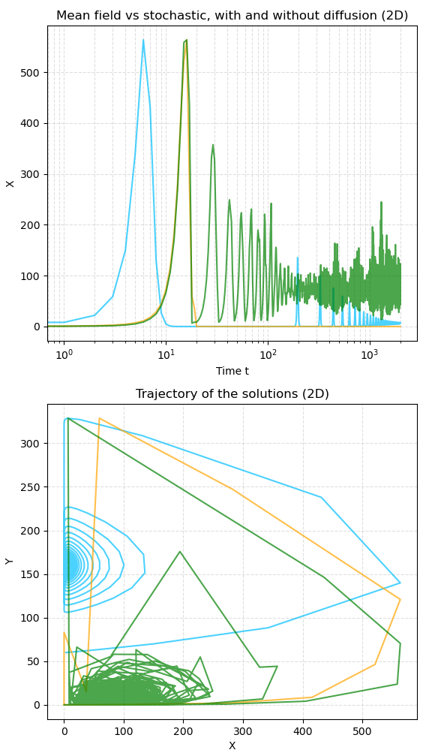
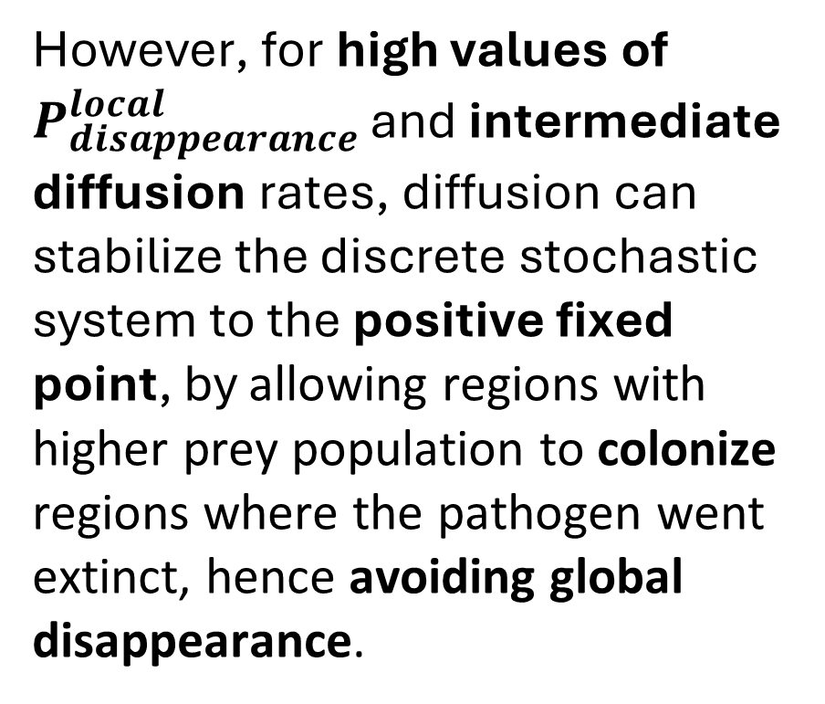
DIFFUSION STABILIZES THE FIXED POINT
However, for high values of $P_{disappearance}^{local}$ and intermediate diffusion rates, diffusion can stabilize the discrete stochastic system to the positive fixed point, by allowing regions with higher prey population to colonize regions where the pathogen went extinct, hence avoiding global disappearance.
Pietro Malagoli – Direct Percolation in Predator-Prey dynamics
13

Slide 14
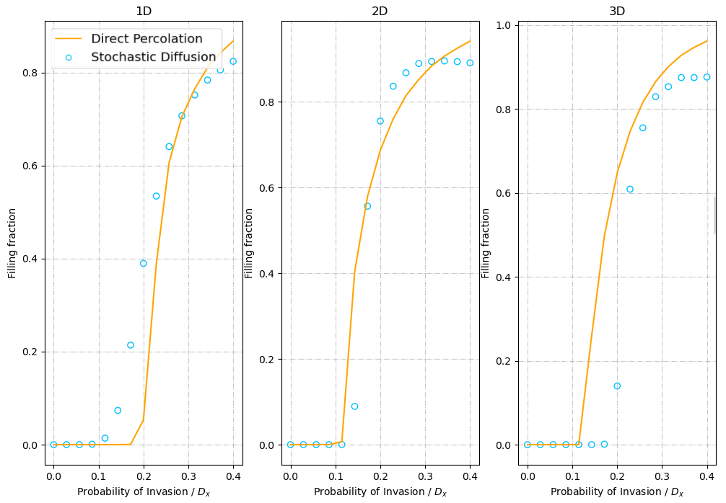
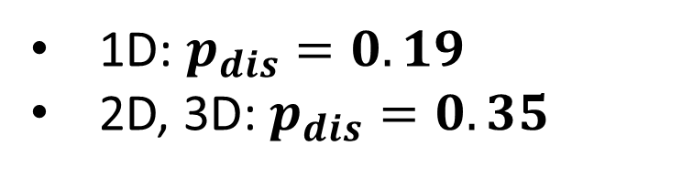
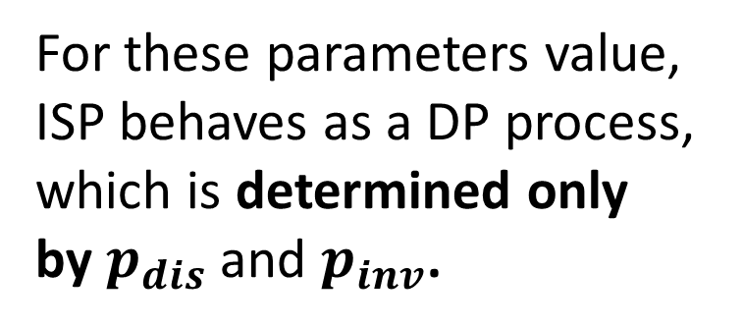
ISP AS A DP PROCESS (1)
The presence of DP regimes in predator-prey models has been already shown in previous publications.
1D: $p_{dis}=0.19$
2D, 3D: $p_{dis}=0.35$
For these parameters value, ISP behaves as a DP process, which is determined only by $p_{dis}$ and $p_{inv}$.
Pietro Malagoli – Direct Percolation in Predator-Prey dynamics
14

Slide 15
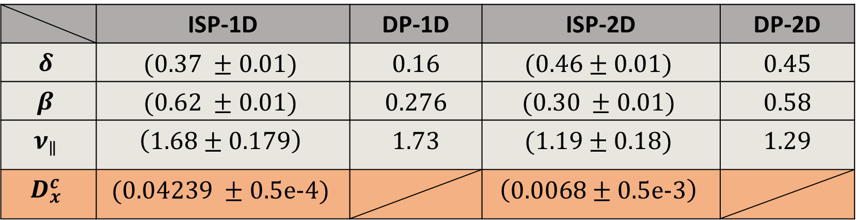
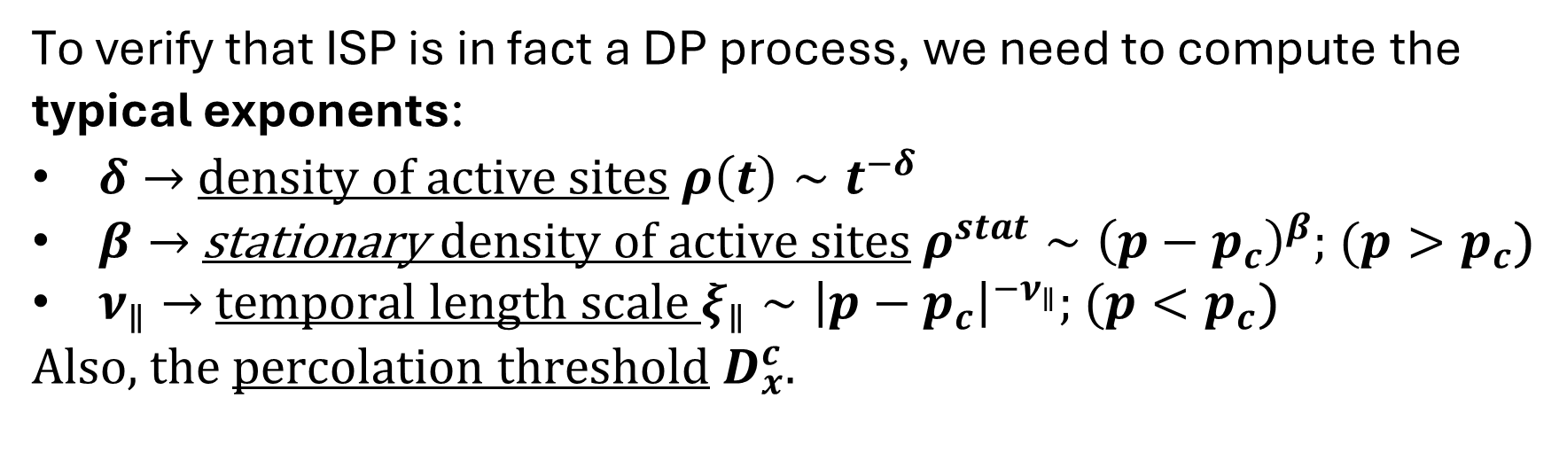
ISP AS A DP PROCESS (2)
To verify that ISP is in fact a DP process, we need to compute the typical exponents:
$δ→$density of active sites $ρ\left(t\right)∼t^{−δ}$
$β→$ stationary density of active sites$ρ^{stat}∼{\left(p−p_{c}\right)}^{β};$ $(p>p_{c}$)
$ν_{∥}→$ temporal length scale $ξ_{∥}∼{\left|p−p_{c}\right|}^{−ν_{∥}};$ $(p<p_{c}$)
Also, the percolation threshold $D_{x}^{c}$.
 | ISP-1D | DP-1D | ISP-2D | DP-2D
$$δ$$ | $$(0.37 ±0.01)$$ | 0.16 | $$(0.46±0.01)$$ | 0.45
$$β$$ | $$(0.62 ±0.01)$$ | 0.276 | $$(0.30 ±0.01)$$ | 0.58
$$ν_{∥}$$ | $$\left(1.68±0.179\right)$$ | 1.73 | $$\text{(1.1}\text{9}±\text{0.18)}$$ | 1.29
$$D_{x}^{c}$$ | $$(0.04239 ±0.5e−4)$$ |  | $$\left(0.0068±0.5e−3\right)$$
Pietro Malagoli – Direct Percolation in Predator-Prey dynamics
15

Slide 16
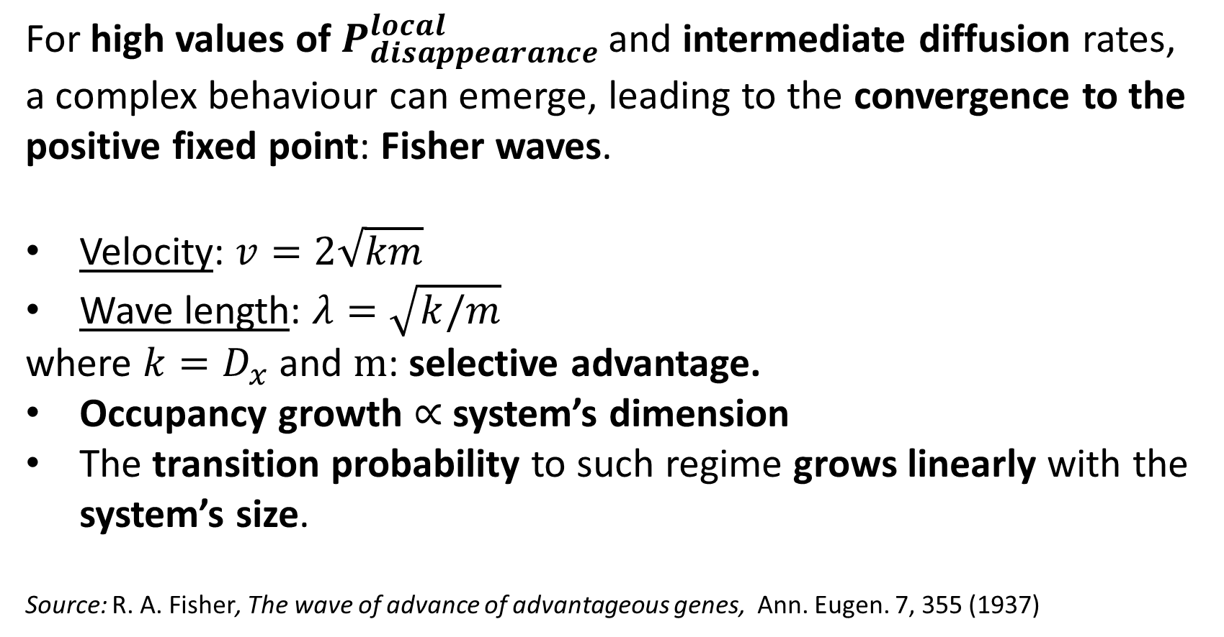
WAVE TRAINS
For high values of $P_{disappearance}^{local}$ and intermediate diffusion rates, a complex behaviour can emerge, leading to the convergence to the positive fixed point: Fisher waves.
Velocity: $v=2\sqrt{km}$
Wave length: $λ=\sqrt{k/m}$
where $k=D_{x}$ and $m$: selective advantage.
Occupancy growth $∝$ system’s dimension
The transition probability to such regime grows linearly with the system’s size.
Source: R. A. Fisher, The wave of advance of advantageous genes, Ann. Eugen. 7, 355 (1937)
Pietro Malagoli – Direct Percolation in Predator-Prey dynamics
16

Slide 17
THANK YOU FOR THE ATTENTION
Pietro Malagoli - Integrated optical multi-ion quantum logic
17

Slide 18
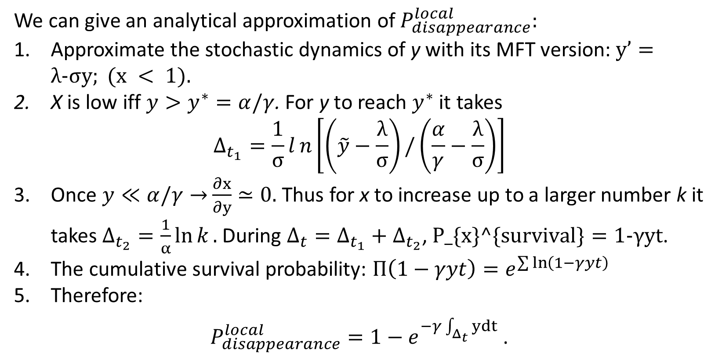
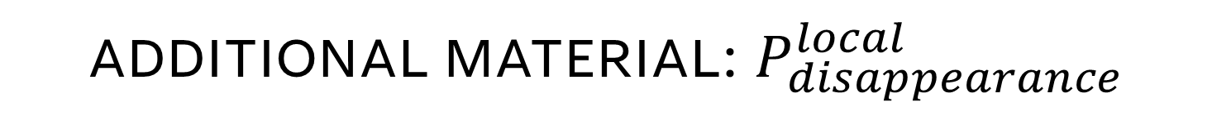
ADDITIONAL MATERIAL: $P_{disappearance}^{local}$
We can give an analytical approximation of $P_{disappearance}^{local}:$
Approximate the stochastic dynamics of y with its MFT version: $y’=λ-σy; (x < 1).$
X is low iff $y>y^{∗}=α/γ$. For y to reach $y^{∗}$ it takes
$$Δ_{t_{1}}=\frac{1}{σ}ln\left[\left(\tilde{y}−\frac{λ}{σ}\right)/\left(\frac{α}{γ}−\frac{λ}{σ}\right)\right]$$
Once $y≪α/γ→$ $\frac{∂x}{∂y}≃0.$ Thus for x to increase up to a larger number k it takes $Δ_{t_{2}}=\frac{1}{α}\ln{k}.$During $Δ_{t}=Δ_{t_{1}}+Δ_{t_{2}}$, $P_\{x\}^\{survival\}=1-γyt$.
The cumulative survival probability: $Π\left(1−γyt\right)=e^{\sum{\ln\left(1−γyt\right)}}$
Therefore:
$P_{disappearance}^{local}=1−e^{−γ\int_{Δ_{t}}{ydt}}$ .
Pietro Malagoli – Direct Percolation in Predator-Prey dynamics
18

Slide 19
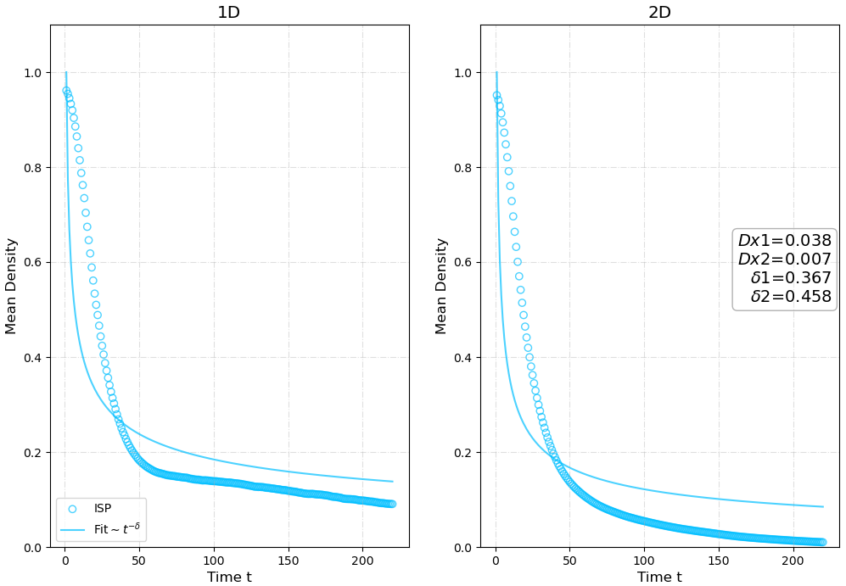

ADDITIONAL MATERIAL: $δ$
Pietro Malagoli – Direct Percolation in Predator-Prey dynamics
19

Slide 20
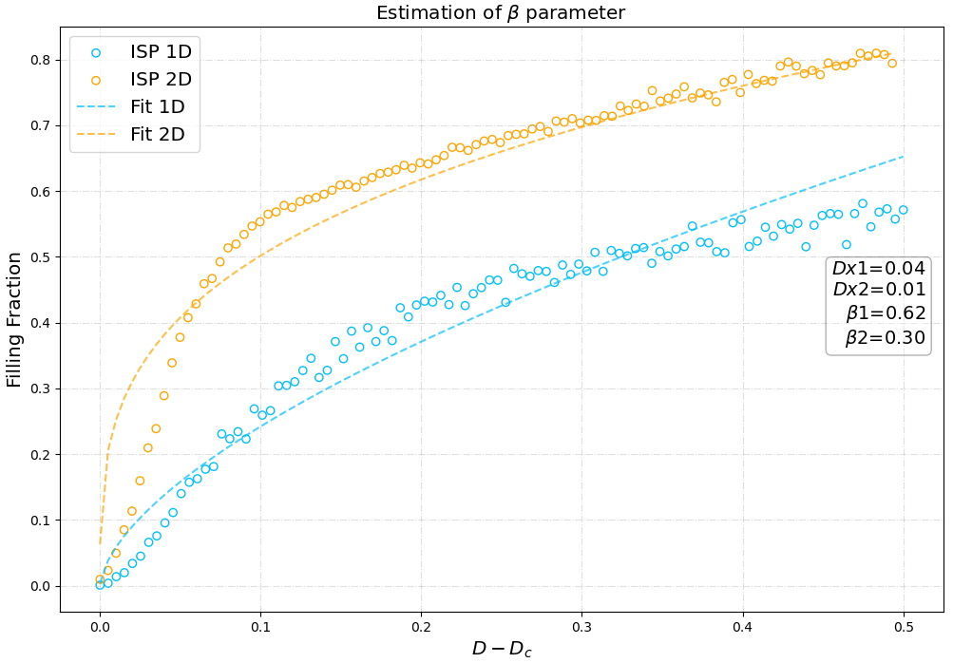

ADDITIONAL MATERIAL: $β$
Pietro Malagoli – Direct Percolation in Predator-Prey dynamics
20

Slide 21
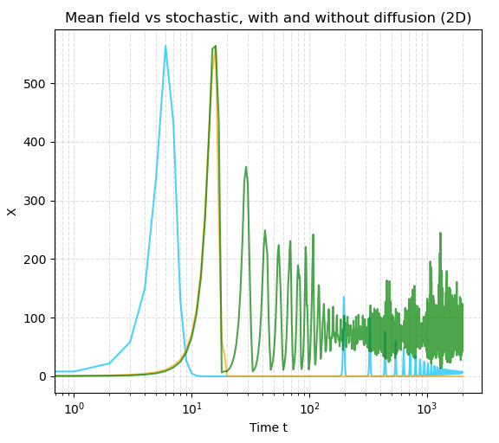
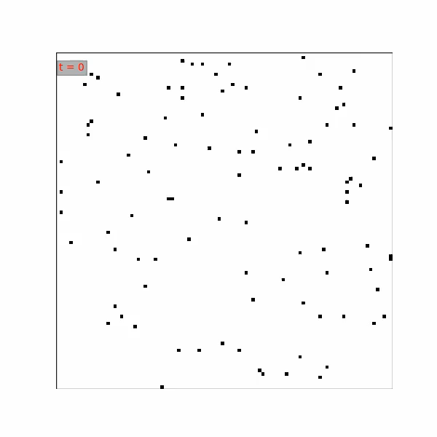
ADDITIONAL MATERIAL: GIF
Pietro Malagoli – Direct Percolation in Predator-Prey dynamics
21

